Slide 1

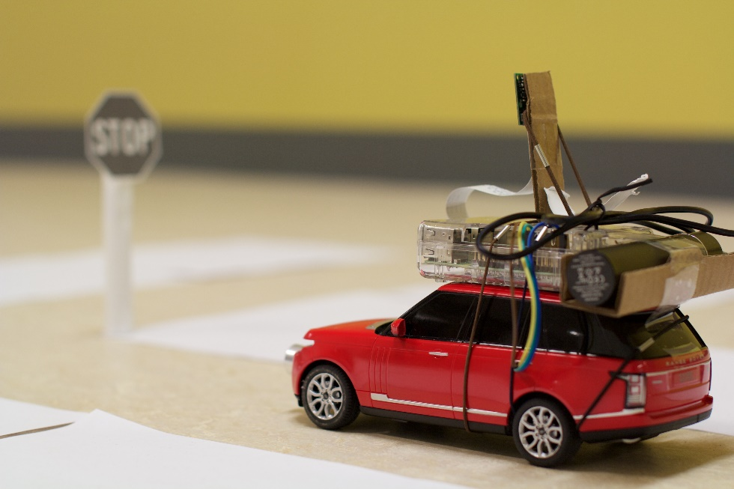


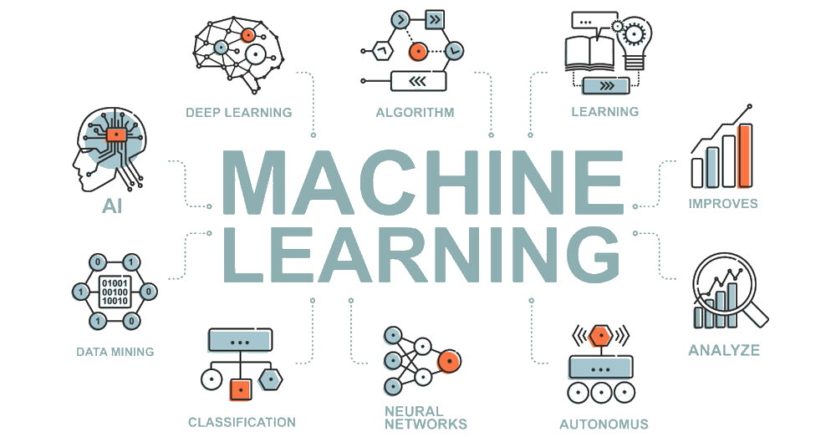
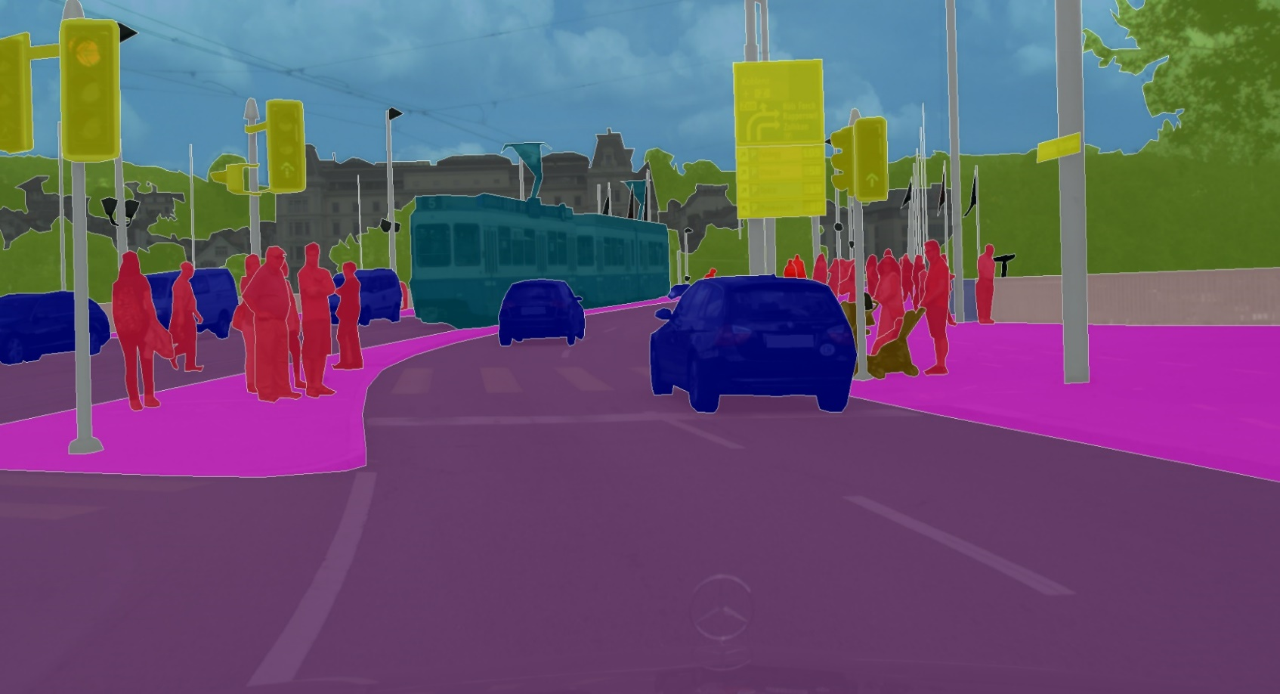

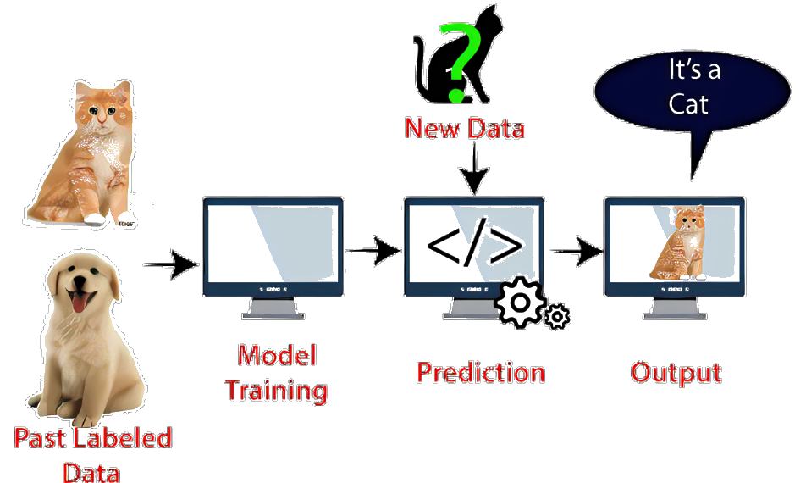
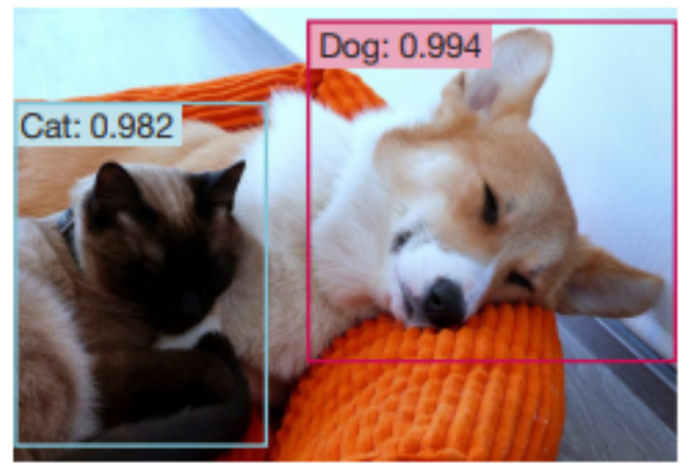
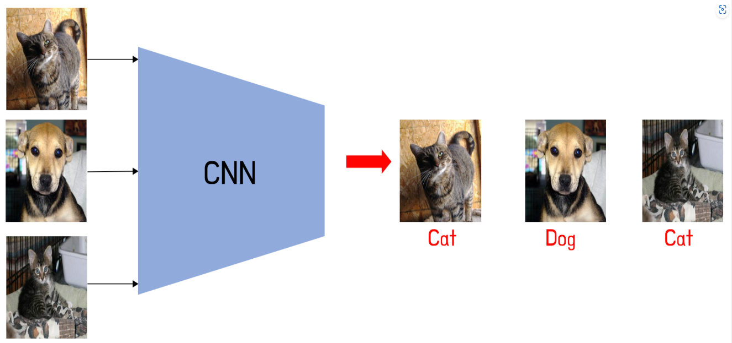

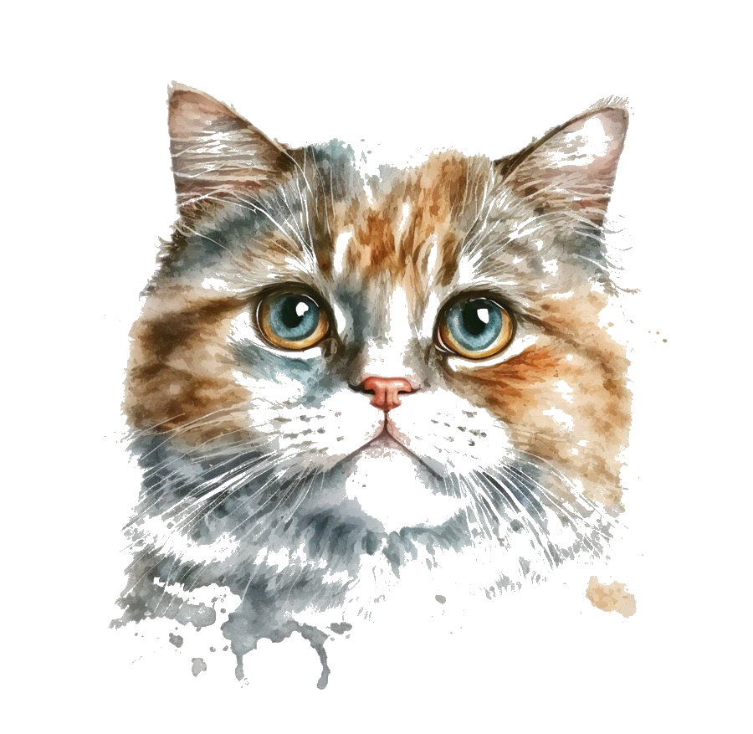


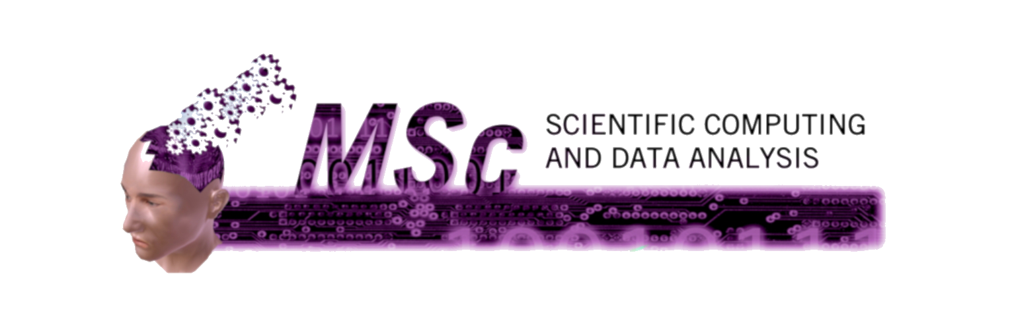
Machine Learning in a Nutshell
For 12-Year-Olds and theirs parents
Da Cui, Haoyang Ding, Ming Xiong, Yiduo Shen, Yunsheng Bai
1
3
Try yourself
Introduction
2
Machine learning allows computers to have brains and make smart decisions through learning. Now we will take you into a magical game world and experience how computers learn!
🚗 Self-Driving Simulator
🎵 Music recommendation game
🐾 Pet Classification Challenge
📘 Intelligent Learning Assistant
🌟 Explore the wonderful world of machine learning! 🌟
Curious about how machines learn?
Want to make learning more fun and interactive?
Scan this QR code and jump into an adventurous mini-game!
🚀 Scan the QR code to start your ML journey now! 🚀
3
Autopilot
Recommender systems
4
Computers can learn how to read traffic lights, how to avoid people and cars, and how to find parking spaces. In this way, the computer can drive you to many places,
such as school or the park.
Whether in movies, music, shopping or news reading platforms, recommender systems can recommend content that users may like based on their historical behaviour, preferences, social networks, and contextual information through complex algorithmic models.
.
Film and TV Recommendations
5
Cat and Dog Prediction
Education and training tools
6
In board games and other strategy games, AI trained through machine learning, such as AlphaGo, can serve as high-level training opponents, helping players learn and practice game strategies.
For example, Go, chess and chess players can improve their game by playing against AI.
What is cat and dog prediction?
Dog and cat prediction in machine learning is like teaching a computer to tell whether an animal in a photo is a cat or a dog.
8
The process is divided into two steps:
Learning: We show the computer some photos labelled "cat" and "dog" so that it can learn what cats and dogs look like.
Prediction: After learning, the computer can look at new photos and guess whether the animal in them is a cat or a dog.

